Slide 1

Forecasting premier league team performances
Ralph Bergisch
Aleksandаr Stoychev
Rowald Paardekooper

Slide 2
Table of contents
Research question
Data
Regression
Decision tree
Random Forest
SVM
Conclusion & Discussion

Slide 3
Research question
Can we predict the points total for every team in the premier league?
Data: Kaggle, Transfermarket
Note: Highly correlated data
Method:
Use the statistics of season T, to predict the points total of season T+1
Estimate the mean absolute error for different models (interpretable)

Slide 4
Models
Ols models:
Standard OLS
Multicollinearity loop
Ridge
Lasso
Decision trees
Random forest
Support Vector Machine

Slide 5


Data
204 instances
Kaggle had 42 attributes
Transfermarket 5 attributes
Final set 41 attributes

Slide 6
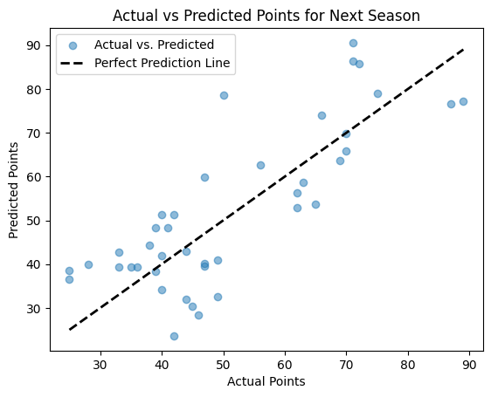
Linear Regression
Mean Squared Error: 121.23177597393502
Mean Absolute Error: 9.420512898666102
Coefficient of determination (R^2): 0.5373253188420686

Slide 7
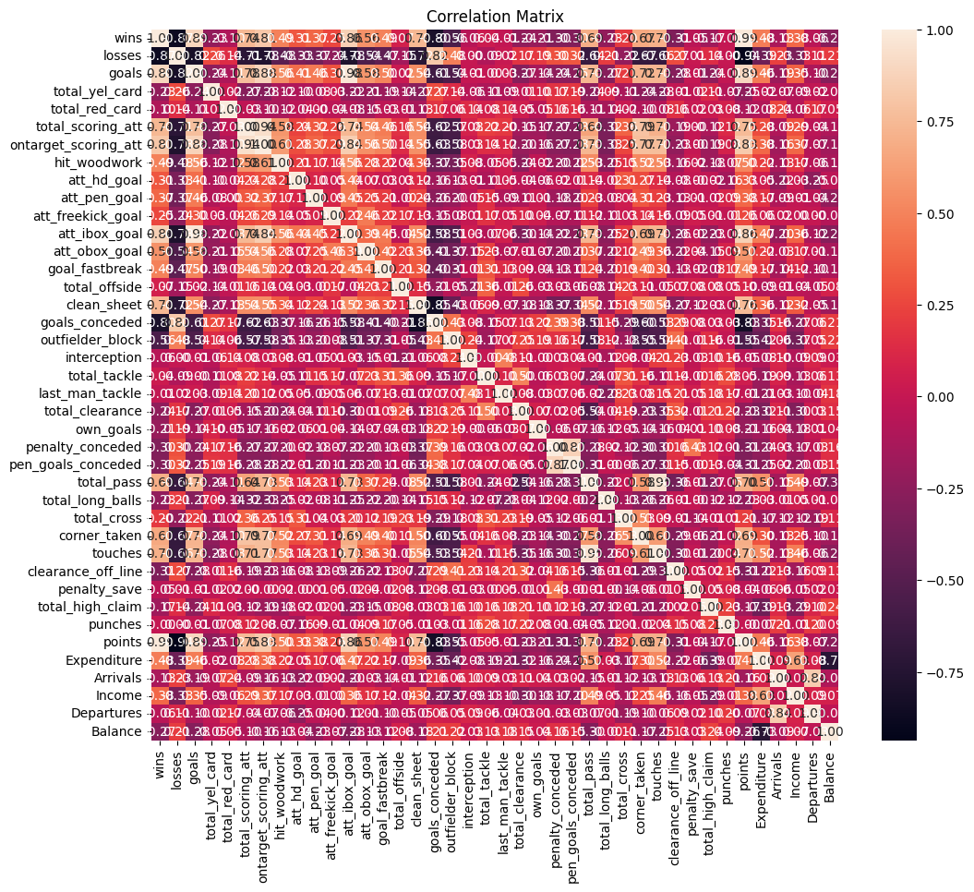
Correlation Matrix
Objective: Examine the interrelationships among predictors to detect multicollinearity.
Range of Values:
+1: Perfect positive correlation.
-1: Perfect negative correlation.
0: No correlation.

Slide 8
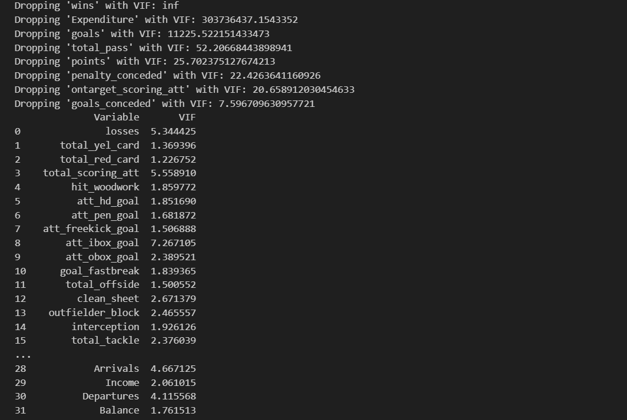
Multicollinearity Reduction
Objective: Eliminate predictors with high multicollinearity to bolster model performance and clarity.
VIF Calculation: Initial VIFs calculated to identify variables with high multicollinearity.
Iterative Removal:
Variables with VIF > 7.5 are sequentially removed.
VIFs recalculated after each removal.

Slide 9
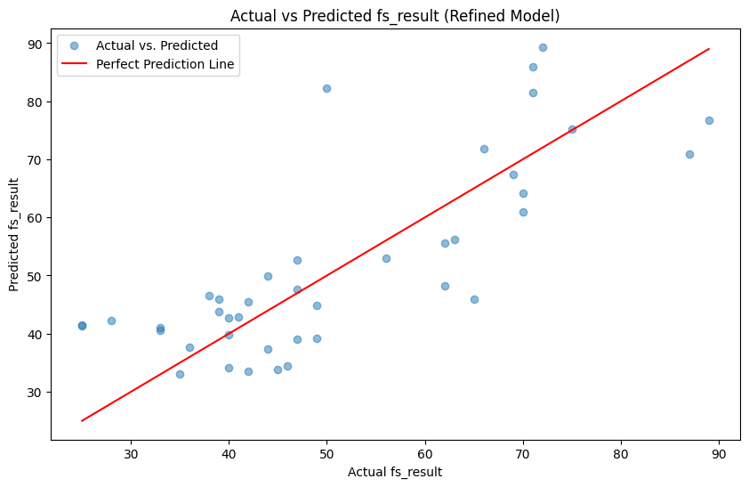
Linear Regression
Mean Squared Error: 111.55964519029038
Mean Absolute Error: 8.476785791137026
Coefficient of determination (R^2): 0.574238496022635

Slide 10
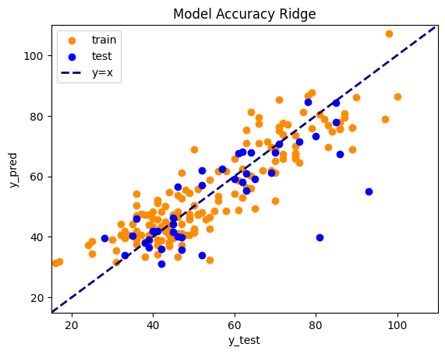
Regression (Ridge)
Penalizes collinearity and puts coefficients to 0
Ran for different alpha levels (penalties)
Alpha = 400 (winner)
MAE of training set: 6.803
MAE of test set: 7.327

Slide 11
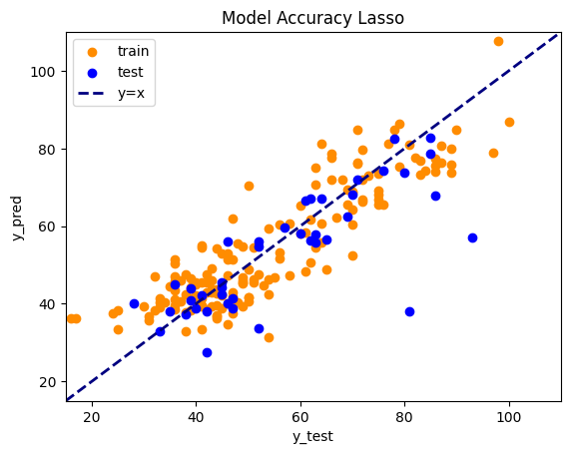
Regression (Lasso)
Penalizes collinearity and mergens coefficients
Ran for different alpha levels (penalties)
Ridge = 0.5 (winner)
MAE of training set: 6.987
MAE of test set: 6.992

Slide 12
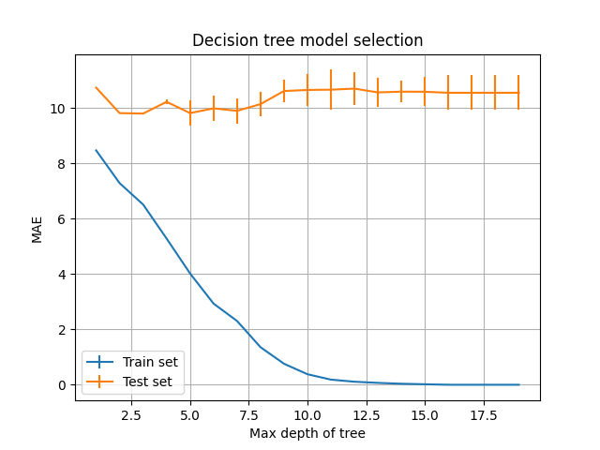
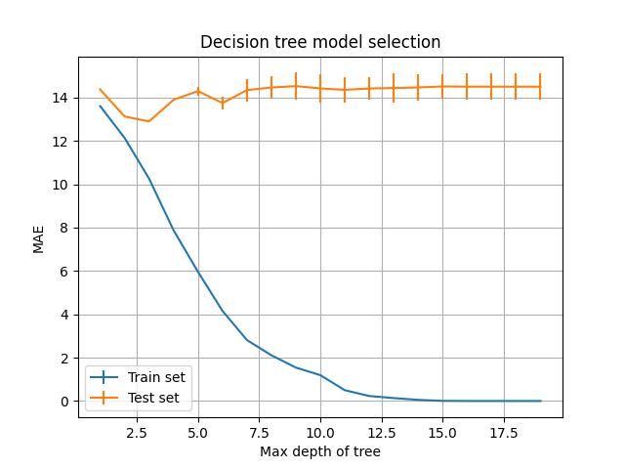
Decision tree

Slide 13
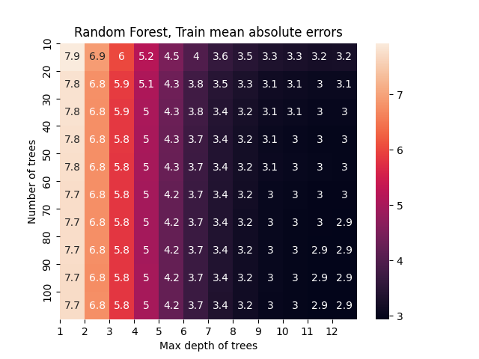
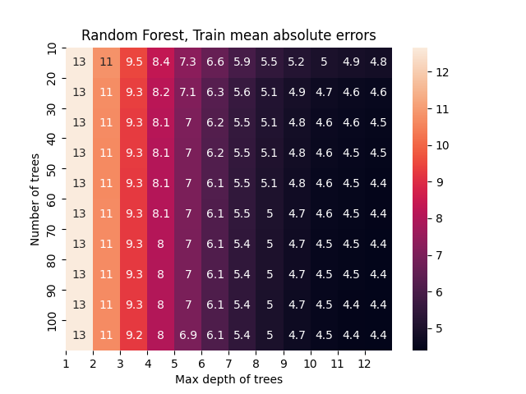
Random forest (train MAE)

Slide 14
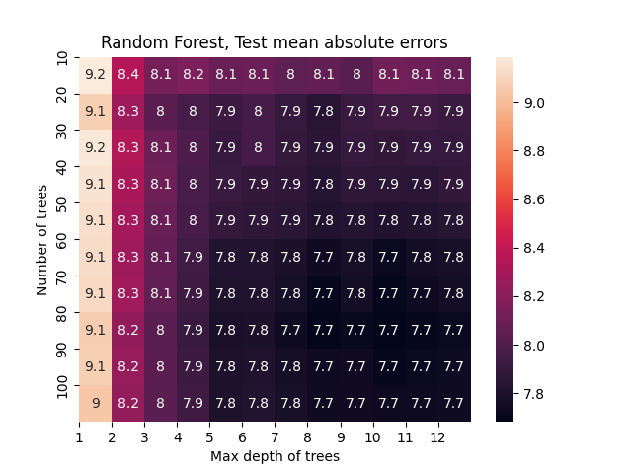
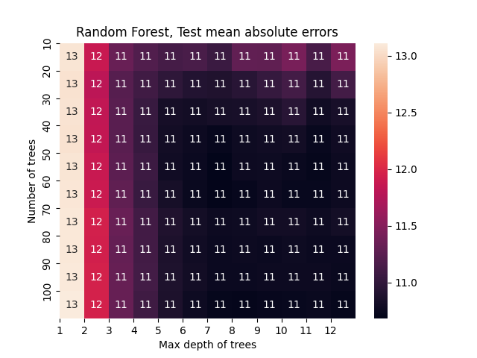
Random forest (test MAE)

Slide 15
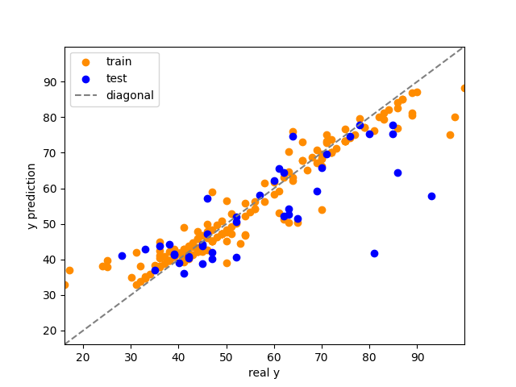
SVM (rbf, c=0.85)
MAE of training set: 3.3
MAE of test set: 7.2

Slide 16
Conclusion & Discussion
Little data
Non optimal attributes
Model Name | Mean Absolute Error
Linear Regression | 9.42
Linear Regression (multicollinearity adjusted) | 8.48
OLS Ridge | 7.33
OLS Lasso | 6.99
Decision Tree | 9.81
Random Forest | 7.70
Support Vector Machine | 7.18

